Slide 1
Support for microdata in SDMX 3.0
SDMX-DDI Interoperability for Data Integration Task Force
February 20, 2025

Slide 2
Why was SDMX 3.0.0 needed?
Reference metadata exchange was too complicated
Geospatial data needed a formal expression
Natural way for modelling microdata was requested
Codelist extension meant creating a separate codelist
Managing version dependencies was inflexible
More flexibility and new features required for mapping
Implementing multiple hierarchies was not intuitive
Improvements to the SDMX APIs, e.g. allowing queries on non-series aspects such as “give me all breaks in series observations”

Slide 3
New features in SDMX 3.0.0
New features to support microdata
  Multiple measures
  Multiple values for attributes
  Simplify DSD Dimensions
  Reference metadata attachment
Support for geospatial information
Enhanced artefacts
  Enhance the constraints artefacts
  Reorganizing constraints
  Improve mapping by enhancing the Structure Set artefact
  Referencing of hierarchical codelists
  Schema attribute attachment at series & group level
Notes:
Many organisations use standard Code Lists, such as Cross Domain Code Lists and domain-specific Code Lists. However, these organisations wish to use a Code List that contains these harmonised codes, but wish to extend this Code List by adding their own codes, or by combining two or more Code Lists into a single Code List.
At present if an organisation wishes to extend a Code List by accessing the codes in an another Code List or multiple Code Lists, the only solution is to create this new Code List ‘by hand’. There is no automation of this process.
This issue is often experienced when a harmonised Code List(s) is not maintained by the organisation wishing to add these codes.

Slide 4
New features in SDMX 3.0.0
Improved codelists' handling
  Codelist extension / composition
  Discriminated union of codelists
Semantic versioning
Enhanced SDMX API
  Support reference metadata in the Restful API
  Deprecation of the SOAP API
  Group all structural metadata queries under a structure resource
  Support resource management - structures and data
  Improve clarity and documentation of the API
  Improved API data queries
Deprecation of obsolete formats
Notes:
Many organisations use standard Code Lists, such as Cross Domain Code Lists and domain-specific Code Lists. However, these organisations wish to use a Code List that contains these harmonised codes, but wish to extend this Code List by adding their own codes, or by combining two or more Code Lists into a single Code List.
At present if an organisation wishes to extend a Code List by accessing the codes in an another Code List or multiple Code Lists, the only solution is to create this new Code List ‘by hand’. There is no automation of this process.
This issue is often experienced when a harmonised Code List(s) is not maintained by the organisation wishing to add these codes.

Slide 5
New features to support microdata
Native support for multiple measures
  Explicit definition of Measures and their representation
  Deprecated the MeasureDimension (can be emulated by a simple Dimension)
  Not fully backwards compatible
New representation for supporting microdata: Array for Measures and Data Attributes
New facets for uncoded Measures and Data Attributes
  Multilingual text
  Sentinel values
Attribute relationship to specific Measures
Support more compact reporting of multiple measures
  All measures reported in a single record
Reference metadata may be reported alongside data
  Attached anywhere in the dataset
Attributes and Measures can have:
  Multiple values (arrays)
  Multilingual uncoded values
  The above combined

Slide 6
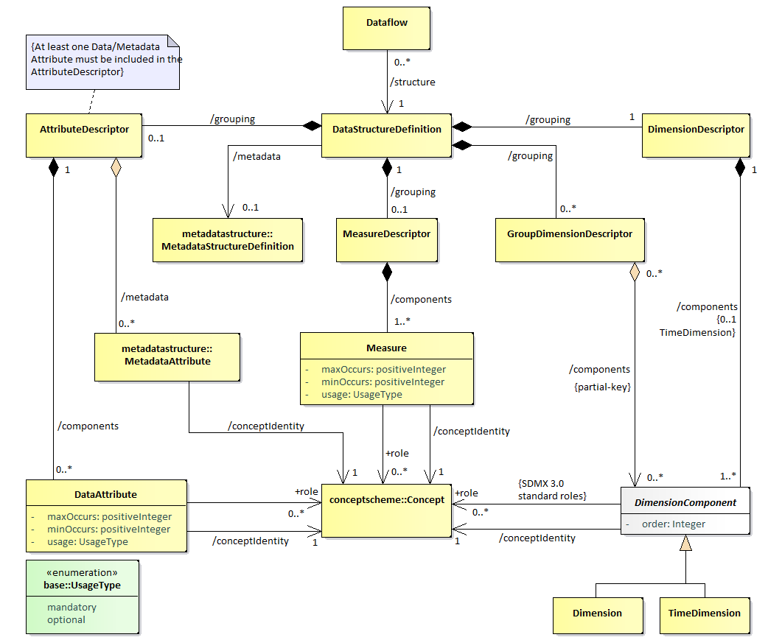
Data Structure Definition

Slide 7
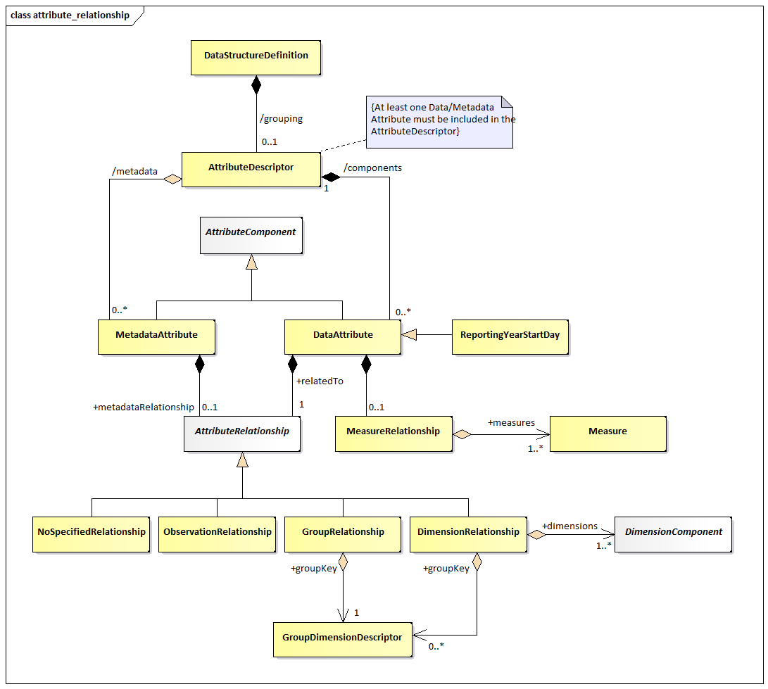
Attribute Relationship

Slide 8
Multiple measures
Equivalent to combining series with the same dimensionality into one
No need to pivot using a ‘special’ Dimension
Natively aligns to VTL dataset
Flexible definition
  Independently specified representation
  Independently defined Concept
  May have roles
  May be explicitly assigned Attributes

Slide 9
Arrays and new Facets
Arrays: Any Attribute or Measures may:
  Specify minimum and/or maximum number of occurrences
  Maximum may be unbounded
Multilingualism support: Uncoded Attributes and Measures may:
  Report their value in many languages, accompanied by a locale
Sentinel Values: Uncoded Attributes and Measures may:
  Specify values, within their data type, with special meaning
  Assign multilingual names to explain those special values

Slide 10
Support for geospatial information
Indirect Reference to Geospatial Information.
  Linking external files with geospatial information
  Backwards compatible approach
  Intended to connect dissemination systems for making use of external tools, like GIS software
Geographic Coordinates.
  Including geospatial coordinates
  Suitable to georeference any kind of statistical information, especially microdata
Geographic Code lists.
  Making use of a special type of Code lists which includes geospatial information
  Can be used to represent coded geographies in both, dimensions and attributes which can have a “Geospatial” role.

Slide 11
Reorganizing constraints
Change 1: AttachmentConstraints are deprecated, due to the lack of use cases.
Change 2: The semantic split of ContentConstraint is removed. ActualConstraints are replaced by the use of the data availability queries.
Change 3: Split the ContentConstraint into DataConstraint and MetadataConstraint as there are two different target groups for constrains (data and metadata)
Change 4: Simplify the metadata related cube region to reflect the changes in the new MSDs.
Change 5: Move the validity period from the Constraint to the constraining terms (CubeRegion, DataKeySet and MetadataTargetRegion).
Change 6: Consider latest stable versions of Constraints per Constrainable artefact as effective Constraints.
Change 7: Attributes to be allowed in DataKeySets, within each KeySet.
Change 8: Allow using the character “%” to wildcard any character(s), either to the right of a specified prefix, or any other part of a Value, and include all items matching that pattern.
Change 9: Allow excluding the root Code when using cascading.

Slide 12
Improved codelists' handling
A Codelist can extend one or more Codelists.
  Codelist extensions are defined as a list of references to parent Codelists.
When two codelists have items with the same Id, the Codelist referenced later takes priority.
  The ‘sequence’ parameter may be used to establish the order that will be used when extending a Codelist
  As the extended Codelist may also include its own Codes, these take the ultimate priority over any extension Codelists.
  A reference to a Codelist may contain a prefix that will be applied to all the codes in the Codelist before they are imported into the extended Codelist.
  An explicit list of item Ids may be provided for inclusion or exclusion.
    May contain ‘wildcards’ using the same notation as Constraints (%).
    ‘Cascading’ values is also supported using the same syntax as the Constraints.
    It is also possible to include children and exclude the Code by using ‘excluderoot’
    Exclusion and inclusion is not supported against a single Codelist at the same time.

Slide 13
The flagship use case: Discriminated Union
Code Lists representing categorical variables may frequently include several variants of the classification.
  For example, the standard classification of economic activities (ISIC) includes several revisions, plus aggregations; each of them is a variant.
  If a unified concept scheme is used for data harmonization across statistical data sources, multiple variants must be supported
These variants are mutually exclusive, in the sense that, although they enumerate the same concept, only one should be used at a time, based on certain context: statistical activity, time reference, representativeness of the sample, etc.
  In SDMX, the “context” is defined by the Dataflow or Provision Agreement.
Two issues to solve:
  the burden of maintaining a huge Code List with all the variants
  the selection of a different subset of codes depending on the PA

Slide 14
The flagship use case: Discriminated Union
The data model
Having independent Code Lists for each variant (i.e. each classification version) solves issue 1.
Make the concept ACTIVITY represented by the Code List CL_ACTIVITY with no codes
CL_ACTIVITY has extension references to CL_ISIC4, CL_ISIC3, CL_NACE2, CL_ECSECTOR, etc..
In the extension clause, a “prefix” attribute is specified for each one, as ISIC4_, ISIC3_, NACE2_, ECSECTOR_, etc. to avoid code collisions.
Each DF has a specific ContentConstraint to keep the items of the variant used by the data source (solves issue 2)

Slide 15
The flagship use case: Discriminated Union
How it works
Each variant in a separate Code List facilitates the maintenance and allows keeping the original codes, regardless of potential conflicts:
  ISIC Rev. 4: “A” represents “Agriculture, forestry and fishing”,
  ISIC 3.1: “A” means “Agriculture, hunting and forestry”
Specifying “prefix=<variant_>” for each Code List in the “ExtendedBy” clause prevents duplicates
  CL_ISIC4 with prefix=“ISIC4_” gets “ISIC4_A”
  CL_ISIC3 with prefix=“ISIC3_” returns “ISIC3_A”.
Each DF has a specific ContentConstraint to include Value=“<variant>_%” items and removePrefix=“<variant>_”, to get the original codes
A query for the DF with references=descendants and detail=referencepartial will return CL_ACTIVITY with the extensions resolved and the constraints applied, so it will only include codes originally from CL_<variant>.

Slide 16
Improved API data queries
Extend the context of data retrieval
  dataflow, data structure, provision agreements
  Search across structures (e.g. all data about a country)
Component-based filters
  /data/dataflow/ESTAT/ICP?c[REF_AREA]=CH&c[CONF_STATUS]=F
Support for operators
  /data/dataflow/ESTAT/ICP?c[ICP_ITEM]=sw:01&c[TIME_PERIOD]=ge:2015
Support for multiple keys
  /data/dataflow/ESTAT/ICP/1.0.0/M…A.ANR,M…A.INX,M…B.CTG

Slide 17
New microdata use cases supported in SDMX 3.0.0
Multiple choice responses, eg surveys
Register information, eg business registers for keeping business information records
Language specific responses
Well-defined diverse measures within a dataset
Arrays for measures and attributes
Qualitative information (reference metadata) next to records
Embedded geospatial information
Supported by other SDMX 3.0 new features:
  Powerful RESTful API
  Simplified, yet flexible, reference metadata design
  Codelist extension and enhanced constraining mechanism
  Updated VTL support
  Geospatial support

Slide 18
Now it is possible with SDMX 3.0.0
Store, exchange and process microdata in SDMX
Reuse reference metadata sets attached to structures or lower level components → DDI-C documentation by IHSN
Have DSD attributes with enhanced “presentation capabilities”
Use SDMX datasets as geospatial input data for GIS applications allowing the use of geospatial analysis tools directly on georeferenced microdata
Make use of global codelists without having to worry about its maintenance
Choose dynamically the variant of a classification depending on the context defined by a Dataflow or a Provision Agreement

Slide 19
Now it is possible with SDMX 3.0.0
Make minor artefacts’ updates not affecting dependencies
Use simpler structure sets to store and share concepts’ mappings
Implement multiple hierarchies in a much simpler and intuitive way than HCL
Use Annotations to drive processes and data visualization
Make queries on non-series aspects such as “give me all women’s records”, or complex queries involving logical operators
Retrieve data from multiple dataflows sharing a single DSD with just one query

Slide 20
Coming soon…
New features in SDMX 3.1.0
Dimension Constraint
  Enables Dataflows to fix their Dimensions to all or a subset of those defined by the DSD to which they adhere.
  Allows a DSD to have additional Dimensions added without undergoing a major version change.
  Minimizes data transfer for “sub-cubes” or segmented datasets as only the subset of concepts specified is included in the data message
  This constraint is specified in the Dataflow
Semantic versioning guideline
  Recommendations on the version level to be incremented for each action affecting an artefact.
Notes:
Extending codelists horizontally
For further thinking (and to be included in SDMX 3.1), I think a “MERGE” (or “JOIN”) option in the Extension of Codelists, allowing to “complete” empty elements in an item with existing information in a matching code item from an extending code list (instead of replacing it as it happens now with the normal treatment of conflicting codes) would work.
For example, if I have a Codelist which items are coded A, B and C, with Names and Descriptions in French, plus some Annotations, and I make an Extension with a Global Codelist containing the same items but only with English labels and no Annotations, normally the resulting codelists should be equal to my own codelist, because all the extending items from the Global Codelist would be discarded due to the conflicting codes. However, if the extension is made with the proposed “MERGE” option, my items are “complemented” with the English translations (which are not present in my codelist) from the extending Global Codelist.
Similar behaviour can be established for Annotations, i.e. the Annotations in my CL remain provided they are not in the extending items; if the same Annotation Type is in both items, the “MERGE” would apply also to the Annotation’s elements, in order to to preserve the localized “ORDER” Annotation of the inherited translations, for example.
Allowing 0 dimensions
Data is designed using different layers covering different concerns (e.g. logical, technical, implementation related).
Designing a high-level Conceptual model capturing the main aspects of the problem domain helps people involved in the design of the data to narrow down its scope. Based on such a Conceptual model subject matter experts in cooperation with data modelling experts may design a Logical Data Model (LDM) capturing the exact business logic of the problem domain in a highly normalised structure. During the design of the LDM no technical considerations are taken into account (“separation of concerns” principle). Because of its highly normalised design the LDM allows to design (forward engineer) different technical or physical data models fulfilling different needs. Examples for such technical or physical data models by their purpose in the data production chain are highly normalised validation models (enforcing referential integrity constraints) and data analysis models for business users to query the data (e.g. models applying a star schema). Another application of the forward engineering procedure of LDMs into physical models concerns the underlying technology. Based on an LDM it is possible to forward engineer physical models for different data base management systems, e.g. relational, graph or file-based data base management systems.
Optimally a Metadata repository is capable to storing logical and technical models. In theory SDMX 3.0 can store most of the relevant aspects of these data models, however it is not capable of storing so called generalizations without primary keys, i.e. Entities that do not have a primary key. Especially in logical data models this modelling construct is used to create abstract Entity types which hold information applicable to different implementation types (having different primary keys). For example, assume that ECB employees and EUROSTAT employees are identified by different identifiers – we may say that they are different objects because they are identified by different primary keys. Both of them are employees and therefore they will have a lot of things in common, e.g. first name, last name, salary. All the things that they have in common may be modelled in an Entity (let’s call it Employee) having no primary key but holding only these Attributes that are common to the two different types. ECB employee and EUROSTAT employee may then inherit from the Entity Employee.
For SDMX 3.0 to be capable of storing logical data models using such a modelling construct the following change request needs to be approved / implemented:
• Enable Data Structure Definitions (DSDs) without Dimensions
• Enable Structure maps without Component maps

Slide 21
Still to come…
Implementation gaps in SDMX 3.x.x
Querying for concepts
  SDMX API query syntax to discover all concepts used in any findable artefact which id matches an expression.
Linked datasets (A.K.A. Foreign keys linking Datasets)
  A single Dataflow (or a “Relationship” artefact) may link to several DSDs which should have some common dimensions, like foreign keys in the relational model.
  Each DSD defines an individual dataset.
  Denormalized model is good for analysis, but…
    Highly redundant
    Issues with duplication of concepts associated to different units
    Data update problems
“Live" database as a concept representation
  Allow the enumeration of a concept by a dataset defined by a DF and a DSD instead of a codelist
Hierarchy level component in codelists
  Allow to specify a Content Constraint by referencing all items at a certain level in the simple hierarchy of a codelist
Notes:
Extending codelists horizontally
For further thinking (and to be included in SDMX 3.1), I think a “MERGE” (or “JOIN”) option in the Extension of Codelists, allowing to “complete” empty elements in an item with existing information in a matching code item from an extending code list (instead of replacing it as it happens now with the normal treatment of conflicting codes) would work.
For example, if I have a Codelist which items are coded A, B and C, with Names and Descriptions in French, plus some Annotations, and I make an Extension with a Global Codelist containing the same items but only with English labels and no Annotations, normally the resulting codelists should be equal to my own codelist, because all the extending items from the Global Codelist would be discarded due to the conflicting codes. However, if the extension is made with the proposed “MERGE” option, my items are “complemented” with the English translations (which are not present in my codelist) from the extending Global Codelist.
Similar behaviour can be established for Annotations, i.e. the Annotations in my CL remain provided they are not in the extending items; if the same Annotation Type is in both items, the “MERGE” would apply also to the Annotation’s elements, in order to to preserve the localized “ORDER” Annotation of the inherited translations, for example.
Allowing 0 dimensions
Data is designed using different layers covering different concerns (e.g. logical, technical, implementation related).
Designing a high-level Conceptual model capturing the main aspects of the problem domain helps people involved in the design of the data to narrow down its scope. Based on such a Conceptual model subject matter experts in cooperation with data modelling experts may design a Logical Data Model (LDM) capturing the exact business logic of the problem domain in a highly normalised structure. During the design of the LDM no technical considerations are taken into account (“separation of concerns” principle). Because of its highly normalised design the LDM allows to design (forward engineer) different technical or physical data models fulfilling different needs. Examples for such technical or physical data models by their purpose in the data production chain are highly normalised validation models (enforcing referential integrity constraints) and data analysis models for business users to query the data (e.g. models applying a star schema). Another application of the forward engineering procedure of LDMs into physical models concerns the underlying technology. Based on an LDM it is possible to forward engineer physical models for different data base management systems, e.g. relational, graph or file-based data base management systems.
Optimally a Metadata repository is capable to storing logical and technical models. In theory SDMX 3.0 can store most of the relevant aspects of these data models, however it is not capable of storing so called generalizations without primary keys, i.e. Entities that do not have a primary key. Especially in logical data models this modelling construct is used to create abstract Entity types which hold information applicable to different implementation types (having different primary keys). For example, assume that ECB employees and EUROSTAT employees are identified by different identifiers – we may say that they are different objects because they are identified by different primary keys. Both of them are employees and therefore they will have a lot of things in common, e.g. first name, last name, salary. All the things that they have in common may be modelled in an Entity (let’s call it Employee) having no primary key but holding only these Attributes that are common to the two different types. ECB employee and EUROSTAT employee may then inherit from the Entity Employee.
For SDMX 3.0 to be capable of storing logical data models using such a modelling construct the following change request needs to be approved / implemented:
• Enable Data Structure Definitions (DSDs) without Dimensions
• Enable Structure maps without Component maps

Slide 22
Still to come…
Implementation gaps in SDMX 3.x
“Primary Key” role
  Every Dimension is a PK, but not every PK is a Dimension.
  The PK (identifier) should coexist with Dimensions in a microdata observation (record)
Measure or Attribute? Or none of them?
  A single Dataflow may link to several DSDs which should have some common dimensions, like foreign keys in the relational model.
  Each DSD defines an individual dataset.
Large volume microdata sets query
  Add new data formats more suitable for large datasets
  Add asynchronous query as a standard feature in SDMX API
Links to other standards
  Define a way of linking to objects in other standards to be easily integrated by an application consuming SDMX data and metadata
Notes:
Extending codelists horizontally
For further thinking (and to be included in SDMX 3.1), I think a “MERGE” (or “JOIN”) option in the Extension of Codelists, allowing to “complete” empty elements in an item with existing information in a matching code item from an extending code list (instead of replacing it as it happens now with the normal treatment of conflicting codes) would work.
For example, if I have a Codelist which items are coded A, B and C, with Names and Descriptions in French, plus some Annotations, and I make an Extension with a Global Codelist containing the same items but only with English labels and no Annotations, normally the resulting codelists should be equal to my own codelist, because all the extending items from the Global Codelist would be discarded due to the conflicting codes. However, if the extension is made with the proposed “MERGE” option, my items are “complemented” with the English translations (which are not present in my codelist) from the extending Global Codelist.
Similar behaviour can be established for Annotations, i.e. the Annotations in my CL remain provided they are not in the extending items; if the same Annotation Type is in both items, the “MERGE” would apply also to the Annotation’s elements, in order to to preserve the localized “ORDER” Annotation of the inherited translations, for example.
Allowing 0 dimensions
Data is designed using different layers covering different concerns (e.g. logical, technical, implementation related).
Designing a high-level Conceptual model capturing the main aspects of the problem domain helps people involved in the design of the data to narrow down its scope. Based on such a Conceptual model subject matter experts in cooperation with data modelling experts may design a Logical Data Model (LDM) capturing the exact business logic of the problem domain in a highly normalised structure. During the design of the LDM no technical considerations are taken into account (“separation of concerns” principle). Because of its highly normalised design the LDM allows to design (forward engineer) different technical or physical data models fulfilling different needs. Examples for such technical or physical data models by their purpose in the data production chain are highly normalised validation models (enforcing referential integrity constraints) and data analysis models for business users to query the data (e.g. models applying a star schema). Another application of the forward engineering procedure of LDMs into physical models concerns the underlying technology. Based on an LDM it is possible to forward engineer physical models for different data base management systems, e.g. relational, graph or file-based data base management systems.
Optimally a Metadata repository is capable to storing logical and technical models. In theory SDMX 3.0 can store most of the relevant aspects of these data models, however it is not capable of storing so called generalizations without primary keys, i.e. Entities that do not have a primary key. Especially in logical data models this modelling construct is used to create abstract Entity types which hold information applicable to different implementation types (having different primary keys). For example, assume that ECB employees and EUROSTAT employees are identified by different identifiers – we may say that they are different objects because they are identified by different primary keys. Both of them are employees and therefore they will have a lot of things in common, e.g. first name, last name, salary. All the things that they have in common may be modelled in an Entity (let’s call it Employee) having no primary key but holding only these Attributes that are common to the two different types. ECB employee and EUROSTAT employee may then inherit from the Entity Employee.
For SDMX 3.0 to be capable of storing logical data models using such a modelling construct the following change request needs to be approved / implemented:
• Enable Data Structure Definitions (DSDs) without Dimensions
• Enable Structure maps without Component maps

Slide 23


Questions?
Thank you for your attention
greising@ilo.org
@egreising

